Slide 1

Advanced Databases Lecture 12: MongoDB /1
Dr. Pierpaolo Dondio,

Slide 2
Some Info
Lab1-5 demo results will be uploaded before Wednesday
Second Demo
ETL lab
Graph DB lab
MongoDB lab(s)
Deadline:
Sunday 9th December, Demo starting Monday 10th December
Other time slots during the week and the following

Slide 3
MongoDB profile
Document-oriented NoSQL database.
Schema-free.
Based on Binary JSON; BSON[2].
Organized in Group of Documents → Collections
Informal namespacing
Auto-Sharding in order to scale horizontally.
Simple query language. Rich, document-based queries.
Map/Reduce support (See more at [7]).
Open Source (GNU AGPL v3.0.)

Slide 4
Motivations
Problems with SQL
Rigid schema
Not easily scalable (designed for 90’s technology or worse)
Requires unintuitive joins
Benefits of mongoDB
Easy interface with common languages (Java, Javascript, PHP, etc.)
DB tech should run anywhere (VM’s, cloud, etc.)
Keeps essential features of RDBMS’s while learning from key-value noSQL systems
Notes:
Quotes from a person

Slide 5
Data Model
Document-Based (max 16 MB)
Documents are in BSON format, consisting of field-value pairs
Each document stored in a collection
Collections
Have index set in common
Like tables of relational db’s.
Documents do not have to have uniform structure

Slide 6
JSON
“JavaScript Object Notation”
Easy for humans to write/read, easy for computers to parse/generate
Objects can be nested
Built on
name/value pairs
Ordered list of values
http://json.org/

Slide 7
BSON
“Binary JSON”
Binary-encoded serialization of JSON-like docs
Also allows “referencing”
Embedded structure reduces need for joins
Goals
Lightweight
Traversable
Efficient (decoding and encoding)
http://bsonspec.org/

Slide 8
BSON Example
{
"_id" : "37010"
"city" : "ADAMS",
"pop" : 2660,
"state" : "TN",
“councilman” : {
name: “John Smith”
address: “13 Scenic Way”
}
}

Slide 9
The _id Field
By default, each document contains an _id field. This field has a number of special characteristics:
Value serves as primary key for collection.
Value is unique, immutable, and may be any non-array type.
Default data type is ObjectId, which is “small, likely unique, fast to generate, and ordered.” Sorting on an ObjectId value is roughly equivalent to sorting on creation time.
http://docs.mongodb.org/manual/reference/bson-types/

Slide 10
The _id field
_id is a 12 bytes hexadecimal number which assures the uniqueness of every document.
You can provide _id while inserting the document. If you don’t provide then MongoDB provides a unique id for every document.
These 12 bytes first 4 bytes for the current timestamp, next 3 bytes for machine id, next 2 bytes for process id of MongoDB server and remaining 3 bytes are simple incremental VALUE.

Slide 11
mongoDB vs. SQL
mongoDB | SQL
Document | Tuple
Collection | Table/View
PK: _id Field | PK: Any Attribute(s)
Uniformity not Required | Uniform Relation Schema
Index | Index
Embedded Structure | Joins
Shard | Partition

Slide 12
Data type
String − This is the most commonly used datatype to store the data. String in MongoDB must be UTF-8 valid.
Integer − This type is used to store a numerical value. Integer can be 32 bit or 64 bit depending upon your server.
Boolean − This type is used to store a boolean (true/ false) value.
Double − This type is used to store floating point values.
Min/ Max keys − This type is used to compare a value against the lowest and highest BSON elements.
Arrays − This type is used to store arrays or list or multiple values into one key.
Timestamp − ctimestamp. This can be handy for recording when a document has been modified or added.
Object − This datatype is used for embedded documents.

Slide 13
Data Type
Null − This type is used to store a Null value.
Symbol − This datatype is used identically to a string; however, it's generally reserved for languages that use a specific symbol type.
Date − This datatype is used to store the current date or time in UNIX time format. You can specify your own date time by creating object of Date and passing day, month, year into it.
Object ID − This datatype is used to store the document’s ID.
Binary data − This datatype is used to store binary data.
Code − This datatype is used to store JavaScript code into the document.
Regular expression − This datatype is used to store regular expression.

Slide 14
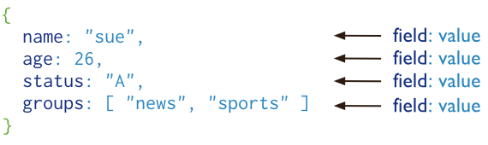
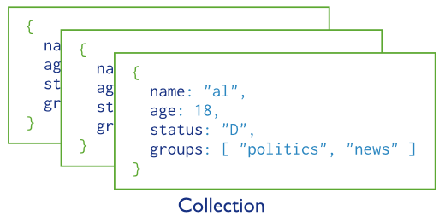
Basic operations
users

Slide 15
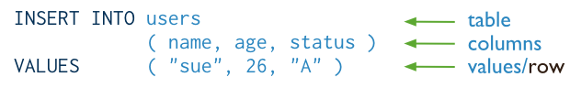
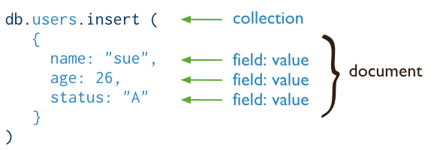
CRUD operations - create
Insert a new user.
SQL
MongoDB

Slide 16
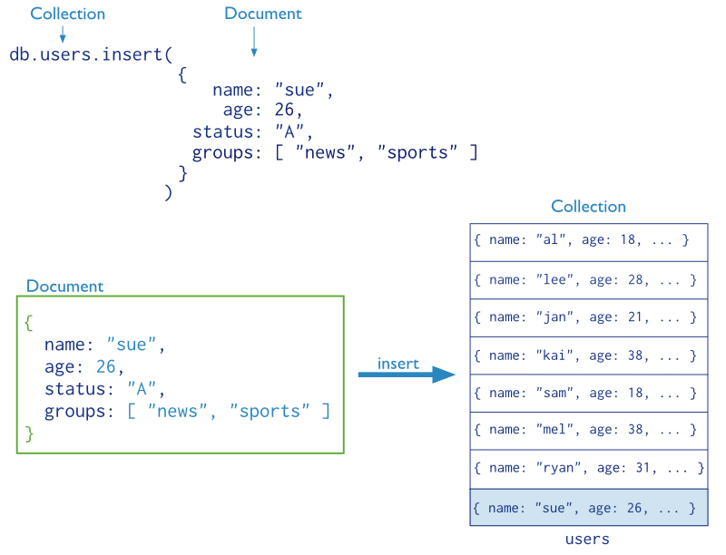
CRUD operations – create (cont’d)

Slide 17
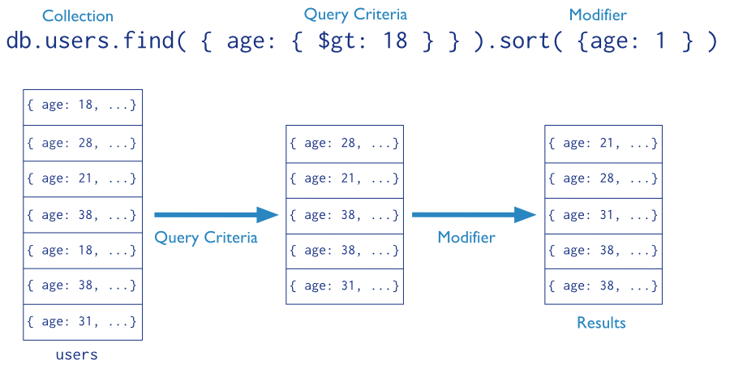
CRUD operations - read
Find the users of age greater than 18 and sort by age.

Slide 18
Logical tests
Operation | Syntax | Example | RDBMS Equivalent
Equality | {<key>:<value>} | db.mycol.find({"by":"tutorials point"}).pretty() | where by = 'tutorials point'
Less Than | {<key>:{$lt:<value>}} | db.mycol.find({"likes":{$lt:50}}).pretty() | where likes < 50
Less Than Equals | {<key>:{$lte:<value>}} | db.mycol.find({"likes":{$lte:50}}).pretty() | where likes <= 50
Greater Than | {<key>:{$gt:<value>}} | db.mycol.find({"likes":{$gt:50}}).pretty() | where likes > 50
Greater Than Equals | {<key>:{$gte:<value>}} | db.mycol.find({"likes":{$gte:50}}).pretty() | where likes >= 50
Not Equals | {<key>:{$ne:<value>}} | db.mycol.find({"likes":{$ne:50}}).pretty() | where likes != 50

Slide 19
Querying
OR
db.<collection>.find({ $or: [
<field>:<value1>
<field>:<value2> ]
})
SELECT *
FROM <table> WHERE <field> = <value1> OR <field> = <value2>;
Checking for multiple values of same field
db.<collection>.find({<field>: {$in [<value>, <value>]}})

Slide 20

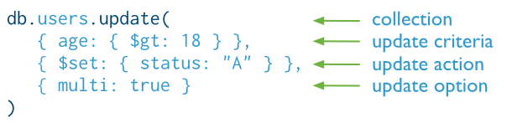
CRUD operations - update
Update the users of age greater than 18 by setting the status field to A.
SQL
MongoDB

Slide 21

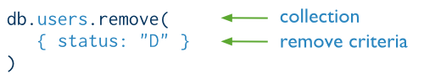
CRUD operations - delete
Delete the users with status equal to D.
SQL
MongoDB

Slide 22
Schema Design

Slide 23
SQL vs Mongo Concepts
RDBMS |  | MongoDB
Database | ➜ | Database
Table | ➜ | Collection
Row | ➜ | Document
Index | ➜ | Index
Join | ➜ | Embedded Document
Foreign Key | ➜ | Reference

Slide 24
Mongo is basically schema-free
The purpose of schema in SQL is for meeting the requirements of tables and SQL implementation
Every “row” in a database “table” is a data structure, much like a “struct” in C, or a “class” in Java. A table is then an array (or list) of such data structures
So we what we design in mongoDB is basically same way how we design a compound data type binding in JSON

Slide 25
There are some patterns
Embedding Embed the document into the other document
Similar to denormalized joins
Linking (also known as reference)
Use the id of a document as a field in another document
similar to a FK in SQL

Slide 26
One to One relationship - embedding
zip = {
_id: 35004,
city: “ACMAR”,
loc: [-86, 33],
pop: 6065,
State: “AL”
}
council_person = {
zip_id = 35004,
name: “John Doe",
address: “123 Fake St.”,
Phone: 123456
}
zip = {
_id: 35004 ,
city: “ACMAR”
loc: [-86, 33],
pop: 6065,
State: “AL”,
council_person: {
name: “John Doe",
address: “123 Fake St.”,
Phone: 123456
}
}

Slide 27
One to many relationship - embedding
book = {
title: "MongoDB: The Definitive Guide",
authors: [ "Kristina Chodorow", "Mike Dirolf" ]
published_date: ISODate("2010-09-24"),
pages: 216,
language: "English",
publisher: {
name: "O’Reilly Media",
founded: "1980",
location: "CA” }
}

Slide 28
One to many relationship – Linking
publisher = {
_id: "oreilly",
name: "O’Reilly Media",
founded: "1980",
location: "CA"}
book = {
title: "MongoDB: The Definitive Guide",
authors: [ "Kristina Chodorow", "Mike Dirolf" ]
published_date: ISODate("2010-09-24"),
pages: 216,
language: "English",
publisher_id: "oreilly"}

Slide 29
Linking vs. Embedding
Embedding is a bit like pre-joining data
Document level operations are easy for the server to handle
Embed when the “many” objects always appear with (viewed in the context of) their parents.
Linking when you need more flexibility, less redundancy

Slide 30
Modeling Checkouts
student = {
_id: "joe"
name: "Joe Bookreader",
join_date: ISODate("2011-10-15"),
address: { ... }
}
book = {
_id: "123456789"
title: "MongoDB: The Definitive Guide",
authors: [ "Kristina Chodorow", "Mike Dirolf" ],
...
}

Slide 31
Modeling Checkouts
student = {
_id: "joe"
name: "Joe Bookreader",
join_date: ISODate("2011-10-15"),
address: { ... },
checked_out: [
{ _id: "123456789", checked_out: "2012-10-15" },
{ _id: "987654321", checked_out: "2012-09-12" },
...
]
}

Slide 32
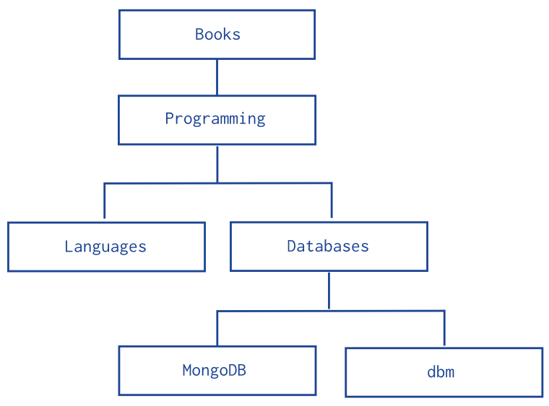
Model Tree Structure
db.categories.insert( { _id: "MongoDB", parent: "Databases" } ) db.categories.insert( { _id: "dbm", parent: "Databases" } ) db.categories.insert( { _id: "Databases", parent: "Programming" } ) db.categories.insert( { _id: "Languages", parent: "Programming" } ) db.categories.insert( { _id: "Programming", parent: "Books" } ) db.categories.insert( { _id: "Books", parent: null } )
db.categories.findOne( { _id: "MongoDB" } ).parent
db.categories.ensureIndex( { parent: 1 } )
db.categories.find( { parent: "Databases" } )

Slide 33
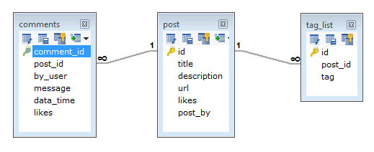
Another Example
Suppose a client needs a database design for his blog/website and see the differences between RDBMS and MongoDB schema design. Website has the following requirements.
Every post has the unique title, description and url.
Every post can have one or more tags.
Every post has the name of its publisher and total number of likes.
Every post has comments given by users along with their name, message, data-time and likes.
On each post, there can be zero or more comments.

Slide 34
MongoDB Document
{
_id: POST_ID
title: TITLE_OF_POST,
description: POST_DESCRIPTION,
by: POST_BY,
url: URL_OF_POST,
tags: [TAG1, TAG2, TAG3],
likes: TOTAL_LIKES,
comments: [
{
user:'COMMENT_BY',
message: TEXT,
dateCreated: DATE_TIME,
like: LIKES
},
{
user:'COMMENT_BY',
message: TEXT,
dateCreated: DATE_TIME,
like: LIKES
}
]
}

Slide 35
Some considerations while designing Schema in MongoDB
Design your schema according to user requirements.
Combine objects into one document if you will use them together. Otherwise separate them (but make sure there should not be need of joins).
Duplicate the data (but limited) because disk space is cheap as compare to compute time.
Do joins while write, not on read.
Optimize your schema for most frequent use cases.
Do complex aggregation in the schema.

Slide 36
Index in MongoDB

Slide 37
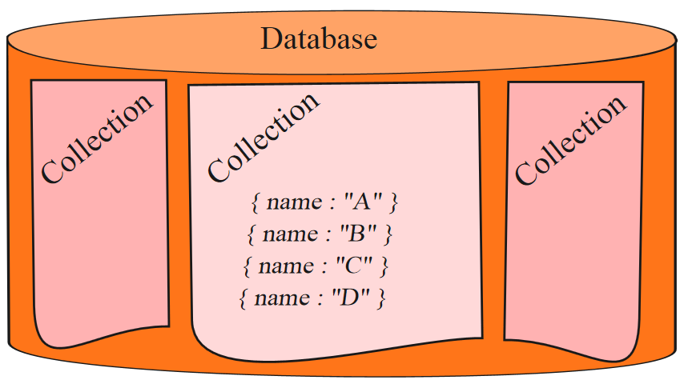

Before Index
What does database normally do when we query?
MongoDB must scan every document.
Inefficient because process large volume of data
db.users.find( { score: { “$lt” : 30} } )

Slide 38
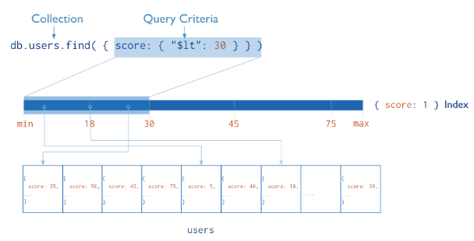
Definition of Index
Definition
Indexes are special data structures that store a small portion of the collection’s data set in an easy to traverse form.
Index
Diagram of a query that uses an index to select

Slide 39
Index in MongoDB
Creation index
db.users. createIndex( { score: 1 } )
Show existing indexes
db.users.getIndexes()
Drop index
db.users.dropIndex( {score: 1} )

Slide 40
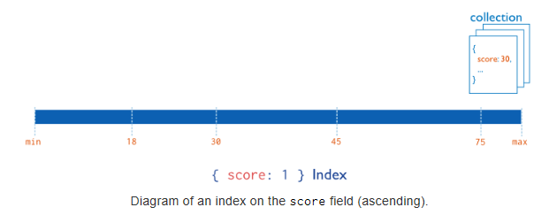
Index in MongoDB
Types
Single Field Indexes
Compound Field Indexes
Multikey Indexes
Single Field Indexes
db.users. createIndex( { score: 1 } )

Slide 41
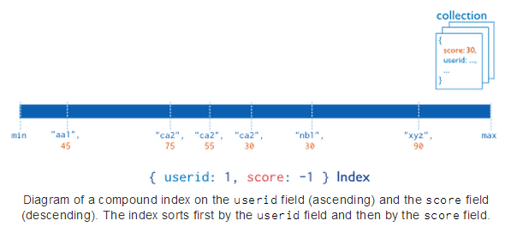
Index in MongoDB
Types
Single Field Indexes
Compound Field Indexes
Multikey Indexes
Compound Field Indexes
db.users. createIndex( { userid:1, score: -1 } )

Slide 42
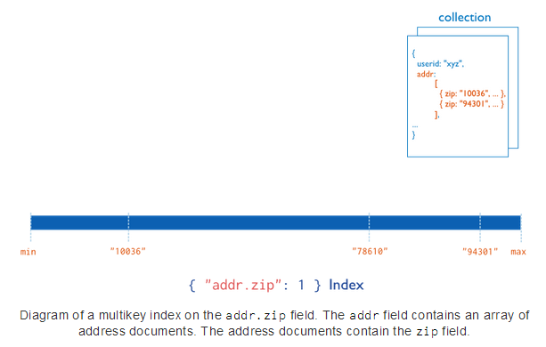
Index in MongoDB
Types
Single Field Indexes
Compound Field Indexes
Multikey Indexes
Multikey Indexes
db.users.createIndex( { addr.zip:1} )

Slide 43
Aggregation
Operations that process data records and return computed results.
MongoDB provides aggregation operations
Running data aggregation on the mongod instance simplifies application code and limits resource requirements.
Aggregation can be done with
Papeline ($group operator)
Map_reduce

Slide 44
Pipelines
MongoDB’s aggregation framework is modeled on the concept of data processing pipelines. Documents enter a multi-stage pipeline that transforms the documents into an aggregated result.
The most basic pipeline stages provide filters that operate like queries and document transformations that modify the form of the output document.
Other pipeline operations provide tools for grouping and sorting documents by specific field or fields as well as tools for aggregating the contents of arrays
Pipeline stages can use operators for tasks such as calculating the average or concatenating a string.
Pipeline is the preferred method for data aggregation in MongoDB.

Slide 45
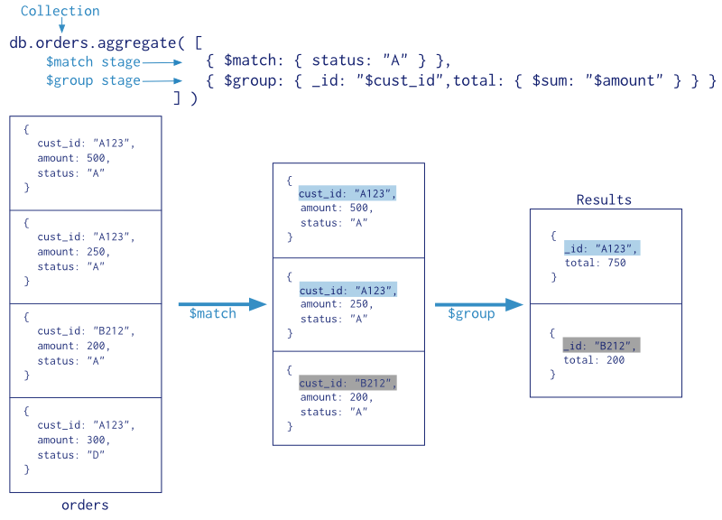
Aggregation using pipeline

Slide 46
Aggregator Operators
Expression | Description | Example
$sum | Sums up the defined value from all documents in the collection. | db.mycol.aggregate([{$group : {_id : "$by_user", num_tutorial : {$sum : "$likes"}}}])
$avg | Calculates the average of all given values from all documents in the collection. | db.mycol.aggregate([{$group : {_id : "$by_user", num_tutorial : {$avg : "$likes"}}}])
$min. $min | Gets the minimum of the corresponding values from all documents in the collection. | db.mycol.aggregate([{$group : {_id : "$by_user", num_tutorial : {$min : "$likes"}}}])
$push | Inserts the values to an array in the resulting document. | db.mycol.aggregate([{$group : {_id : "$by_user", url : {$push: "$url"}}}])
$addToSet | Inserts the value to an array in the resulting document but does not create duplicates. | db.mycol.aggregate([{$group : {_id : "$by_user", url : {$addToSet : "$url"}}}])
$first | Gets the first document from the source documents according to the grouping. Typically this makes only sense together with some previously applied “$sort”-stage. | db.mycol.aggregate([{$group : {_id : "$by_user", first_url : {$first : "$url"}}}])
$last | Gets the last document from the source documents according to the grouping. Typically this makes only sense together with some previously applied “$sort”-stage. | db.mycol.aggregate([{$group : {_id : "$by_user", last_url : {$last : "$url"}}}])

Slide 47
Some examples
db.test_db.find({gender: 'f'});
db.test_db.find({gender: 'm'});
db.test_db.find({gender: 'm', $or: [{nationality: 'english'}, {nationality:'american'}]});
db.test_db.find({gender: 'm', $or: [{nationality: 'english'},{nationality: 'american'}]}).sort({nationality: -1});
db.test_db.find({gender: 'm', $or: [{nationality: 'english'},{nationality: 'american'}]}).sort({nationality: -1, first: 1});
db.test_db.find({gender: 'm', $or: [{nationality: 'english'},{nationality: 'american'}]}).limit(2);
db.test_db.update({first: 'james', last: 'caan'}, {$set:{hair_colour: 'brown'}});
db.test_db.update({ nationality: "american" },{ $inc: { age: 2} })
db.test_db.aggregate( [ { $match: { 'age' : { '$gte' : 37 }}}, {$group: { _id: '$nationality', total : { $sum : 1} }}] );
db.test_db.aggregate( [ { $match: { 'age' : { '$gte' : 37 }}}, {$group: { _id: '$gender', total : { $sum : 1} }}] );
db.test_db.aggregate( [ {$group: { _id: '$gender', avg_age : { $avg : '$age'} }}] );

Slide 48
Output from a shell
Some practical tips
When running from a script:
Output of a query is not displayed by default, use the following function to display it.
function get_results (result)
{ print(tojson(result)); }
db.col.find(…).forEach(get_results…)

Slide 49
Documents Update
MongoDB does not allow to update a field by using an expression containing other fields of the collections
Therefore, you cannot write $field = $field + 1 or something similar (as we did for SQL)
For numeric update, use the $inc operator with updatefunction
Or.. Javascript always an option!
Example:
{ _id: 1, item: "abc123", quantity: 10, metrics: { orders: 2, ratings: 3.5 } }
db.products.update( { item: "abc123" }, { $inc: { quantity: -2, "metrics.orders": 1 } } )

Slide 50
Multiple Updates
Add {multi: true). It controls the ability of mongoDB to update more than one field in a single query
Try:
> db.pierpaolo.update({first: { $ne: "aa"} },{ $inc: {age : 2}})
WriteResult({ "nMatched" : 1, "nUpserted" : 0, "nModified" : 1 })
> db.pierpaolo.update({first: { $ne: "aa"} },{ $inc: {age : 2}},{multi: true})
WriteResult({ "nMatched" : 7, "nUpserted" : 0, "nModified" : 7 })

Slide 51
Mongo & Javascript
You can store your commands in a js script and execute them with
mongo js_file.js

Slide 52
Shell – Script Commands
SHELL show dbs, show databases | JS SCRIPT db.adminCommand('listDatabases')
use <db> | db = db.getSiblingDB('<db>')
show collections | db.getCollectionNames()

Slide 53
Cursors
var myCursor = db.inventory.find( { type: 'food' } );
while (myCursor.hasNext()) { print(tojson(myCursor.next())); }
myCursor.forEach(printjson);
var documentArray = myCursor.toArray();
var myDocument = documentArray[3];
var myDocument = myCursor[3];

Slide 54
Map Reduce
Algorithm (“template”) to perform distributed parallel computation
Used in MongoDB for performing distributed queries, for instance aggregated queries
MongoDB provides the function map-reduce
Map reduce is a concept from functional programming
map even [3,4,5,6,7,9] = [4,6]

Slide 55
Map-Reduce
Has two phases:
A map stage that processes each document and emits one or more objects for each input document
A reduce phase that combines the output of the map operation.
An optional finalize stage for final modifications to the result
Uses Custom JavaScript functions
Provides greater flexibility but is less efficient and more complex than the aggregation pipeline
Can have output sets that exceed the 16 megabyte output limitation of the aggregation pipeline.

Slide 56
Map reduce in MongoDB
db.runCommand( {
mapReduce: <collection>,
map: <function>,
reduce: <function>,
{
out: <output>,
query: <document>,
sort: <document>,
limit: <number>,
}
finalize: <function>,
verbose: <boolean> } )

Slide 57
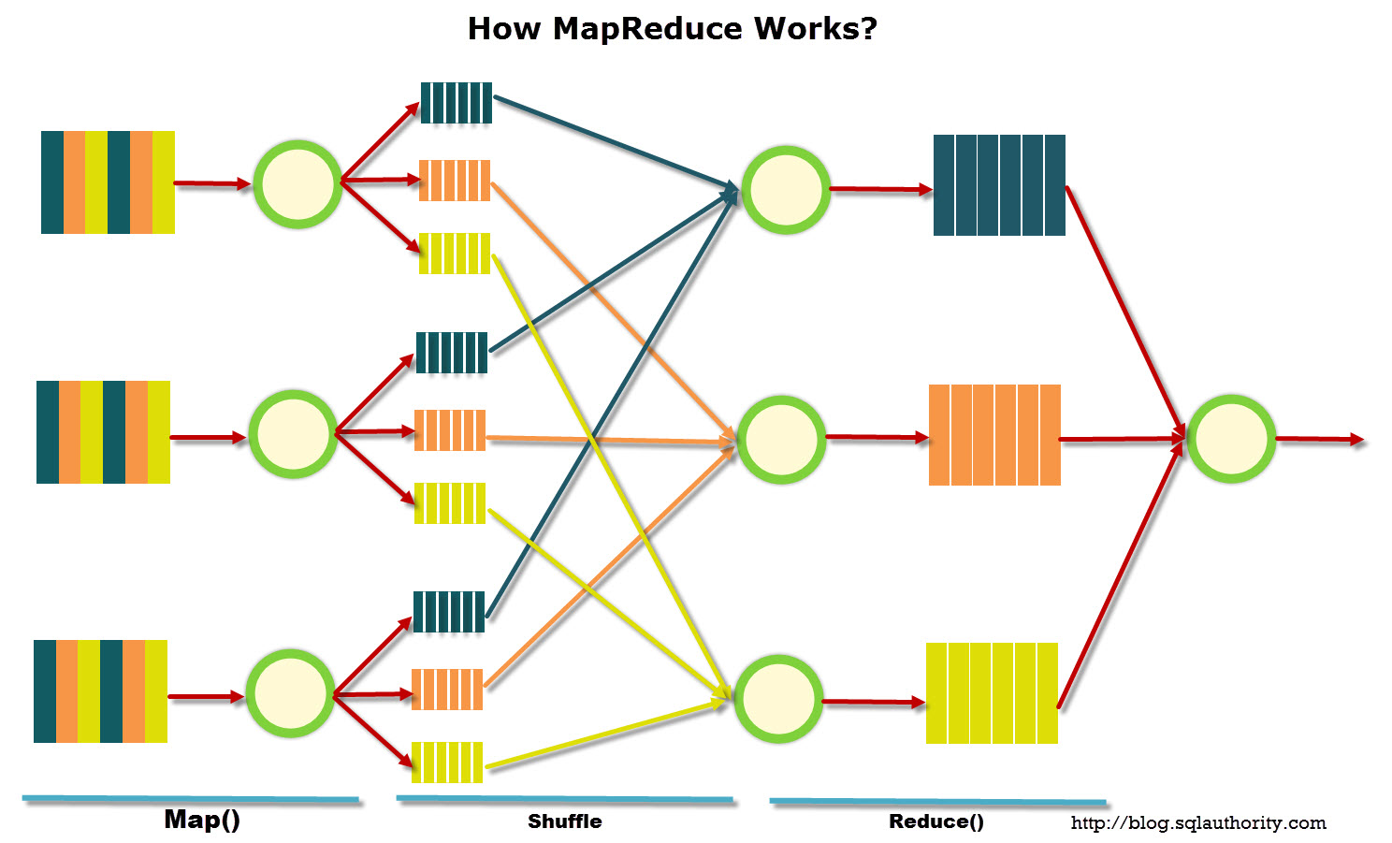
Map Reduce

Slide 58
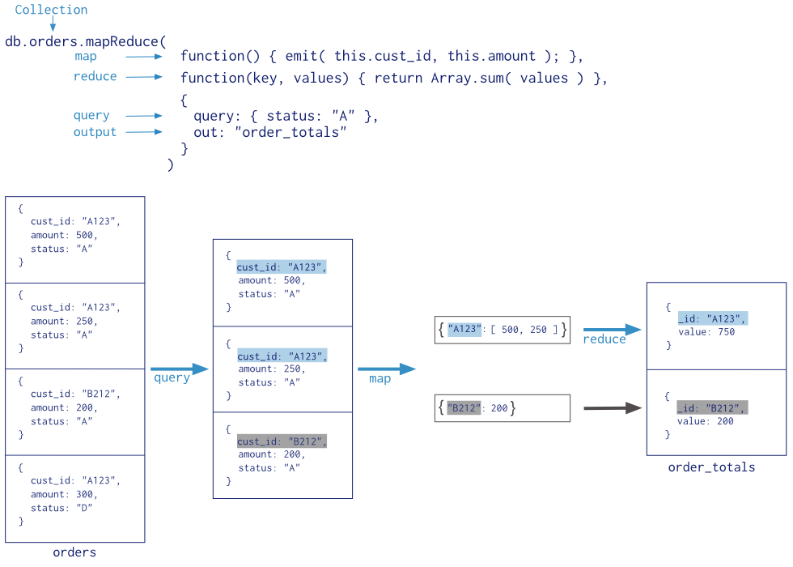
Map-Reduce Example

Slide 59
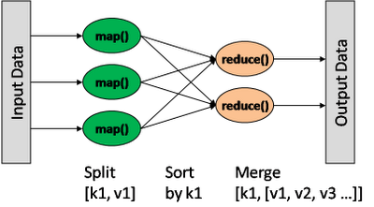
Map/Reduce
db.collection.mapReduce(
<mapfunction>,
<reducefunction>,
{
out: <collection>,
query: <>,
sort: <>,
limit: <number>,
finalize: <function>,
verbose: <boolean>
} )
var mapFunction1 = function() { emit(this.cust_id, this.price); };
var reduceFunction1 = function(keyCustId, valuesPrices)
{ return sum(valuesPrices); };
Notes:
http://docs.mongodb.org/manual/reference/method/db.collection.mapReduce/#db.collection.mapReduce

Slide 60
Map-reduce as JavaScript
In MongoDB, map-reduce operations use custom JavaScript functions to map, or associate, values to a key. If a key has multiple values mapped to it, the operation reduces the values for the key to a single object.

Slide 61
Map function
function() { ... emit(key, value); }
The map function has the following requirements:
In the map function, reference the current document as this within the function.
The map function should not access the database for any reason.
The map function should be pure, or have no impact outside of the function (i.e. side effects.)
The map function may optionally call emit(key,value) any number of times to create an output document associating key with value.

